Slide 1
Information Session

Slide 2
Agenda
Program Overview
2024 Tentative Schedule
Application
Tuition

Slide 3
Values and Core Principles

Slide 4
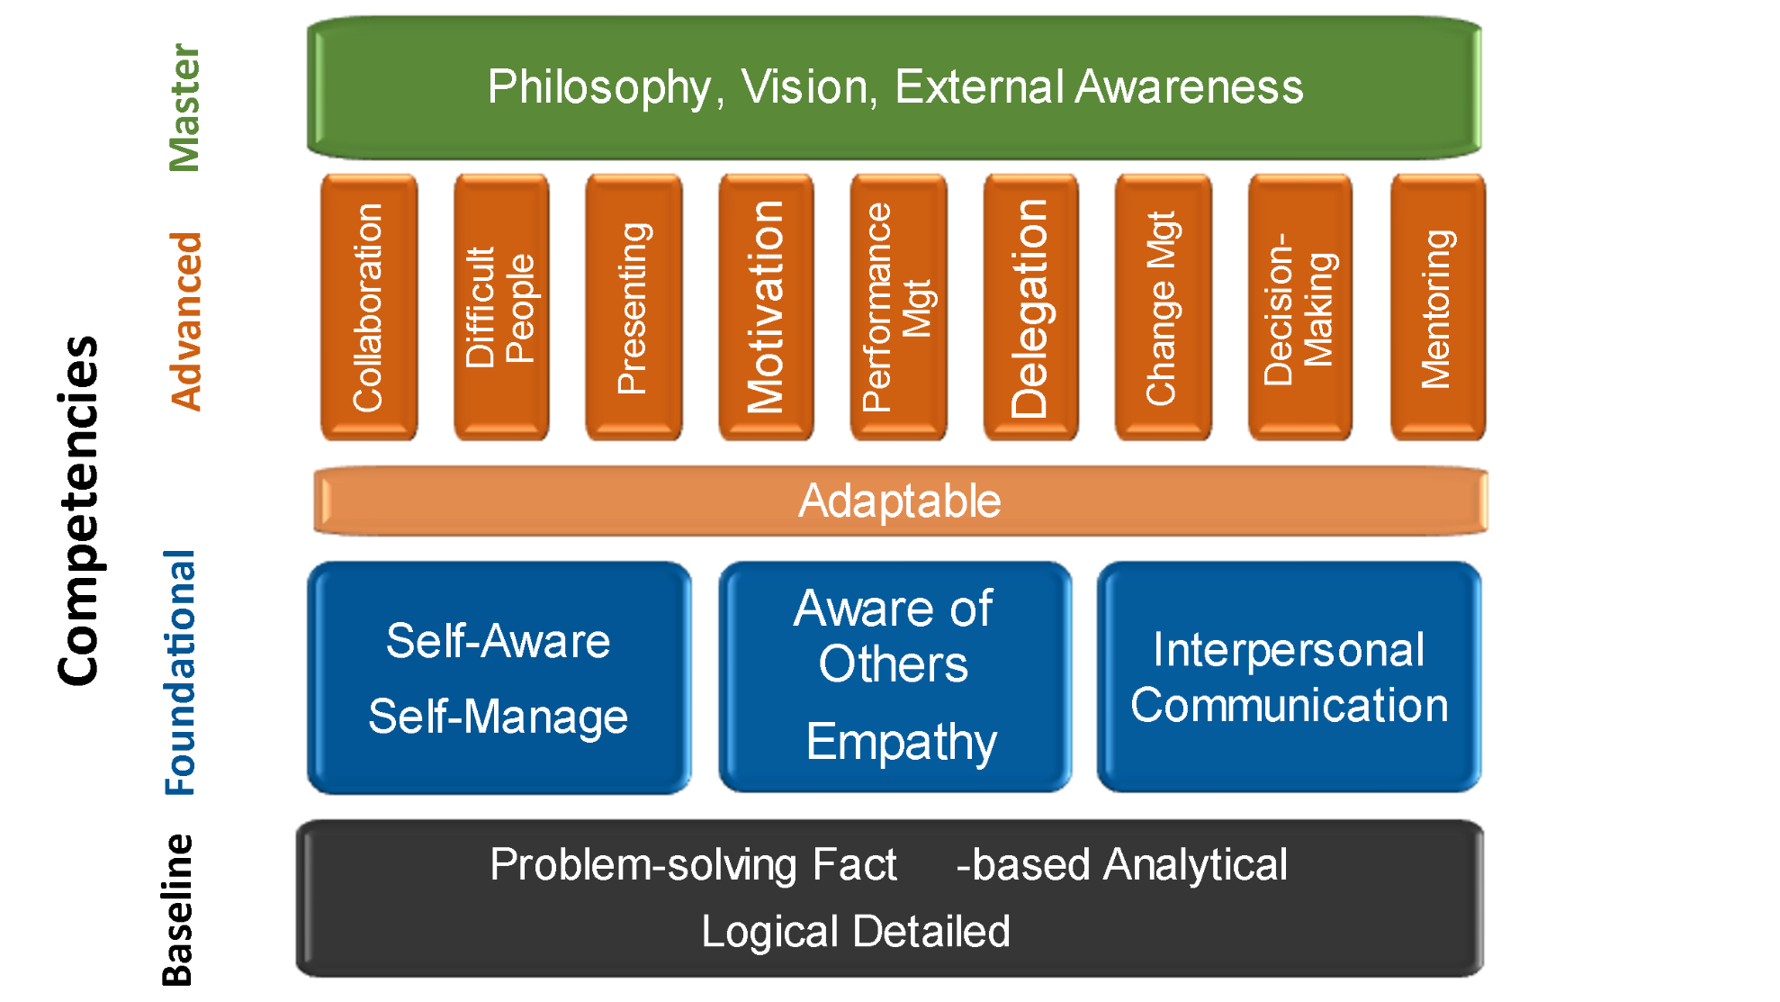
Goals and Objectives

Slide 5
2024 Tentative Schedule
LeadershipITE Orientation Webinar December 11, 2023 |  | Session #7 April 29, 2024 (Virtual)
Session #1 January 6-7, 2024 (In Person – Washington, DC) |  | Session #8 May 20, 2024 (Virtual)
Session #2 Shark Tank January 22, 2024 (Virtual) |  | Session #9 June 10, 2024 (Virtual)
Session #3 February 5, 2024 (Virtual) |  | Session #10 Group Project Final Presentations June 24, 2024 (Virtual)
Session #4 February 26, 2024 (Virtual) |  | Session #111 July 8, 2024 (Virtual)
Session #5 March 18, 2024 (Virtual) |  | Session #12 July 20-21, 2024 (In Person – Philadelphia)
Session #6 April 8, 2024 (Virtual) |  | Graduation at ITE Annual Meeting July 23, 2024 (In Person – Philadelphia)
Times for virtual sessions are 2-6PM Eastern

Slide 6
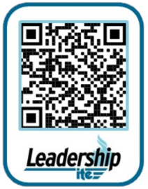
Application
2024 applications are due September 15th
https://www.ite.org/professional-and-career-development/leadershipite/
Letters of Support
Non-employer
Current Employer
Optional: Additional Personal Reference
Resume
Essay Questions

Slide 7
Tuition
Program tuition is $3500
Sample letter to employer
Explains value of LeadershipITE Program
Request support of LeadershipITE participation
Scholarship opportunities
LeadershipITE Legacy Fund Scholarship
LeadershipITE Fred Grove Scholarship
Tuition includes:
9 Virtual Workshops and course materials
2 In Person Sessions
Registration to ITE’s Annual Meeting
District/Section contributes $ to tuition of each member accepted into the program

Slide 8
