Slide 1
Strengthening Mobility and Revolutionizing Transportation (SMART) Stage 1: Planning and Prototyping Grant Program
Purpose Driven Innovation
www.transportation.gov/grants/SMART
Stage 1 Grants:
Up to $2M
18 month project period
NOFO open until July 12, 2024 (5pmET)
Eligible entities:
a State or a political subdivision of a State
a Tribal government
a public transit agency or authority
a public toll authority
Addresses Real World Challenges
Builds Local Technology Capacity
DOT anticipates this will be the last year to apply for Stage 1. Only recipients of Stage 1 grants can apply for Stage 2: Implementation Grants.

Slide 2
Projects should address at least 1 Technology Area
Application Information:
www.transportation.gov/grants/SMART/apply
NOFO
'How to Apply' Webinar May 28 (recording posted)
Frequently Asked Questions
Application Aids
Illustrative Use Cases
Smart Grid
Sensor-Based
Infrastructure
Commerce Delivery
& Logistics
Smart Traffic
Signals
Coordinated
Automation
Innovative
Aviation
Connected
Vehicles
Systems
Integration
Already awarded:
93 SMART projects in 40 states + D.C. and Puerto Rico
Notes:
[TARA]
So the eight technology areas are smart grid, sensor-based infrastructure, commerce delivery and logistics, smart technology traffic signals, coordinated automation, innovative aviation, connected vehicles, and systems integration. We did a deep dive on each of these in our first SMART webinar, so I would encourage you to go onto the SMART website to watch that recording if you're interested in hearing the exact definitions from congress and some further clarity we provided.

Slide 3
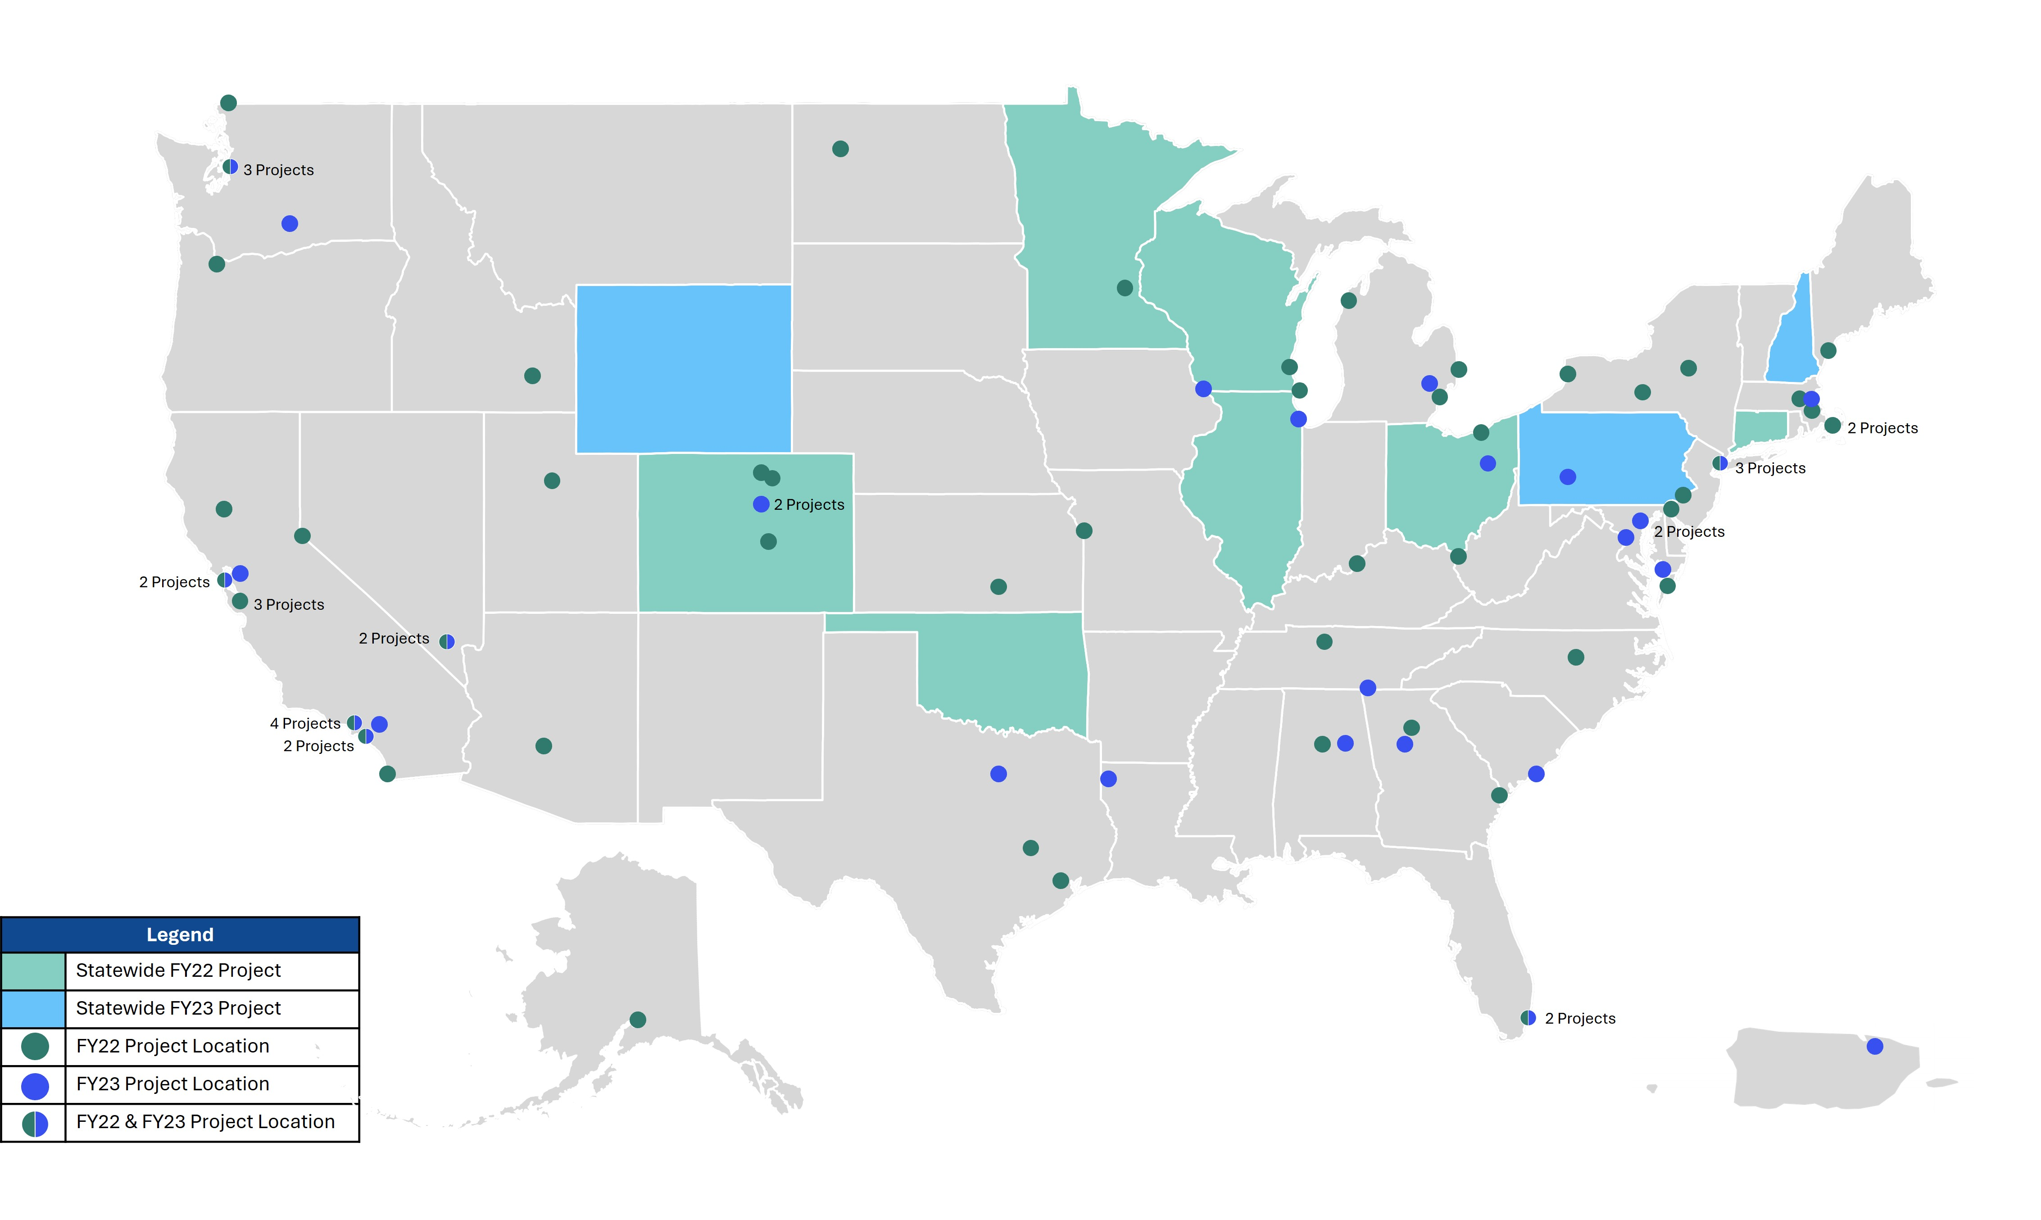
Map of all SMART Projects
Optional Additional Slide

